Slide 1
CS 2600 Computer Networks I Dr. Sayeed Sajal Lecture 23 4G, LTE and 5G

Slide 2
Long Term Evolution (LTE)
The ITU IMT Initiative says “4G” must deliver 100Mbps downloads to moving users and 1Gbps to stationary users
LTE is a set of standards that provides a transition path to 4G
E-UTRAN is the official 3GPP name for LTE (the “marketing” name)
We’re currently running LTE Release 8 in the U.S. (aka “3.9G”), a 3GPP technology that should provide ~100Mbps down and ~50Mbps up for mobile users
Despite claims to the contrary by carriers, LTE Rel. 8 is not 4G (by the ITU definition) because it doesn’t provide the required data rates
LTE-Advanced (LTE Release 10) should have been true 4G (1Gbps downloads to stationary users), but we’ll probably get 5G first

Slide 3
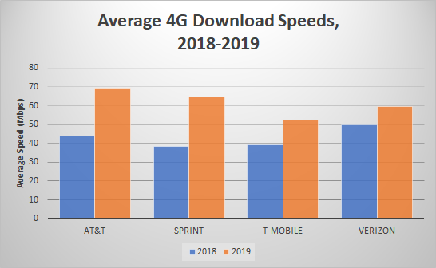
2018-19 Carrier Download Rates*
*U.S. overall
From https://www.pcmag.com/Fastest-Mobile-Networks

Slide 4
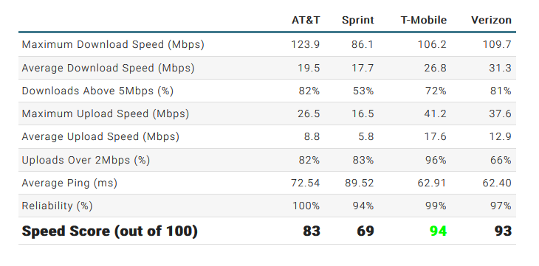
Carrier Performance in Salt Lake City (2017)
From https://www.pcmag.com/article/354110/fastest-mobile-networks-2017/29

Slide 5
Current Cellular Technical Specifications
 | “4G” LTE (3GPP Rel. 8) | 4G (LTE-Advanced) (3GPP Rel. 10) | 5G (3GPP Rel. 15 & 20)
Physical Layer | Downlink: OFDMA* UP: SC-FDMA† | DL: OFDMA UP: SC-FDMA | DL: OFDMA? UP: SC-FDMA?
Duplex Mode | FDD | FDD & TDD** | FDX
Channel Bandwidth | 1.4, 3, 5, 10, 15, 20 MHz | 1.4, 3, 5, 10, 15, 20 MHz | ≤100Mhz (FR1) ≤400MHz (FR2)
Spectrum | 700 – 800MHz | 700 – 800MHz (T-Mobile has 600MHz) | FR1: 600MHz – 6GHz FR2: >24GHz
Peak Data Rates | DL: 302 Mbps UP: 75 Mbps | DL: 1 Gbps UP: 300 Mbps | DL: 10 Gbps (100Mbps – 1Gbps actual) UP: ? Mbps
Spectral Efficiency | DL: 1.91 bps/Hz (2x2)†† UP: 0.72 bps/Hz (1x2) | DL: 30 bps/Hz? UP: 15 bps/Hz? | DL: ? bps/Hz UP: ? bps/Hz
Latency | Link ~30ms Handoff < 50ms | Link ~5ms Handoff < 50ms | Link ~1ms Handoff ~?ms
*Orthogonal Frequency-Division Multiple Access
†Single-Carrier Frequency-Division Multiple Access
**Frequency-Division Duplexing and Time-Division Duplexing
††MIMO antenna configurations such as “2 x 2” are expressed as <# transmit antennas> x <# receive antennas>
Adapted from “WiMAX vs. LTE: Who Will Lead the Broadband Mobile Internet?”, Abichar et al, IT Professional, vol. 12 no. 3

Slide 6
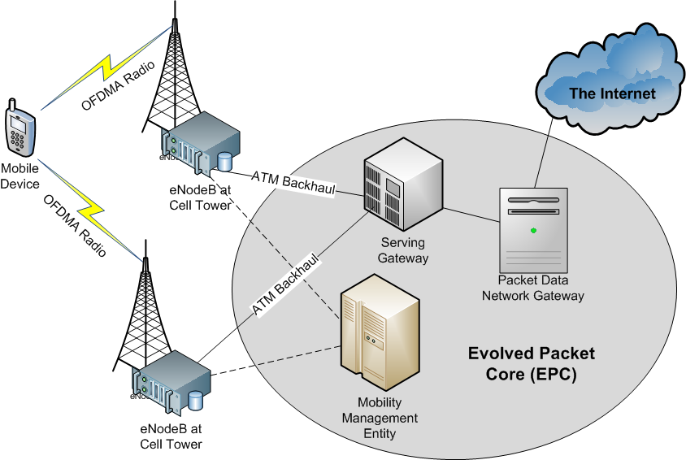
LTE Evolved Packet Core (EPC) Architecture (Applies to 3GPP Release 8 and later)
OFDMA+SC-FDMA Radio
>1–2 Gbps Backhaul
>1–2 Gbps Backhaul

Slide 7
LTE Evolved Packet Core Elements
eNodeB Base Station Controller at the cell tower replaces the 3G Base Station Controller
Serving Gateway (SGW) connects the radio network to the core network, manages subscriber (customer) mobility, and replaces the 3G Mobile Switching Center
Packet Data Network Gateway (PDN GW) connects the carrier backhaul to the Internet and enforces Quality of Service/Quality of Experience and charging for data transmission
Mobility Management Entity (MME) handles signaling and control functions including user authentication, QoS/QoE* negotiation and idle device tracking
*Quality of Experience, similar to the more common term Quality of Service (QoS)

Slide 8
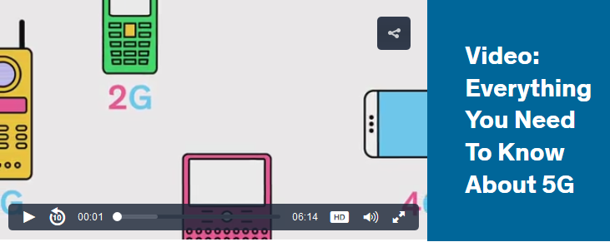
IEEE Spectrum 5G Video (Click on the graphic, scroll way down for video)
https://spectrum.ieee.org/static/the-race-to-5g

Slide 9
5G Use Cases
Greatly enhanced mobile device experience
Low latency VR and gaming
Superior voice quality
Massive Machine Type Communication (mMTC)
An inexpensive way to connect large numbers of IoT devices using minimal energy
Ultra Reliable Machine Type Communication (uRMTC)
Highly reliable, low latency communication for critical devices including factory robots, medical equipment and driverless vehicles

Slide 10
5G Spectrum
Minimize use of radio spectrum below 6GHz
5G’s FR1 (Frequency Range 1) is everything under 6GHz
Max 100MHz channels
Good penetration of building walls/floors/roofs, and trees
3.5GHz band will likely be used by all carriers
FR2 is above 24GHz (“millimeter wavelength”)
50 – 400MHz channels, which can be combined (“bonded”)
Up to 40Gps
Poor structural penetration, but small cells should help

Slide 11
5G Performance Goals
Reduce latency from ~25ms down to 1ms
Important for self-driving cars, high performance games, precision manufacturing robots, etc.
Data rates will be significantly faster
Much depends on how much spectrum becomes available
Goal is 100x faster than 4G, but that won’t happen soon, if ever
Scale up to handle 10’s of billions of IoT devices
Maintain backward compatibility with 4G
Some rural areas may never see 5G
5G NR (“new radio”) devices will contain software-defined radios, allowing significant changes to frequencies and modulation schemes (but not antennas) via software updates
See https://www.lifewire.com/5g-availability-us-4155914 for rollout schedules

Slide 12
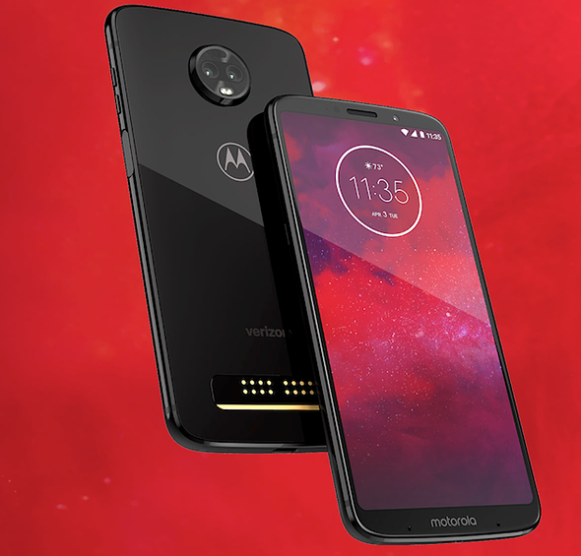
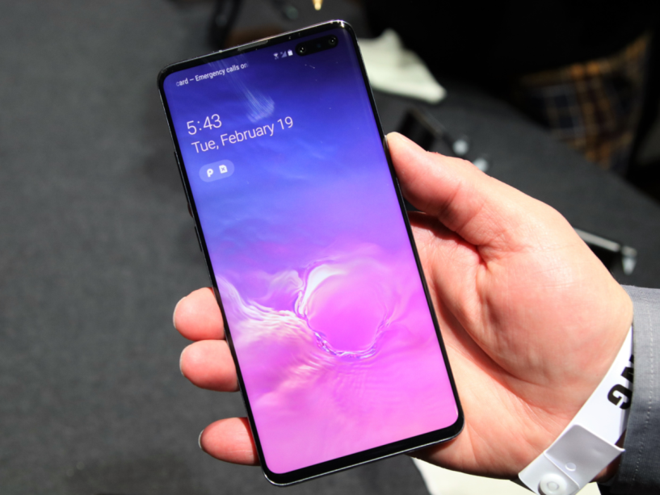
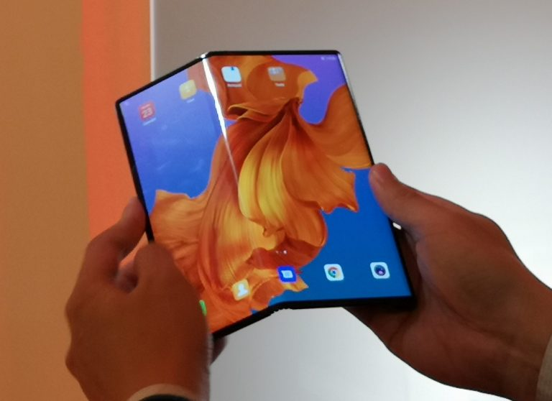
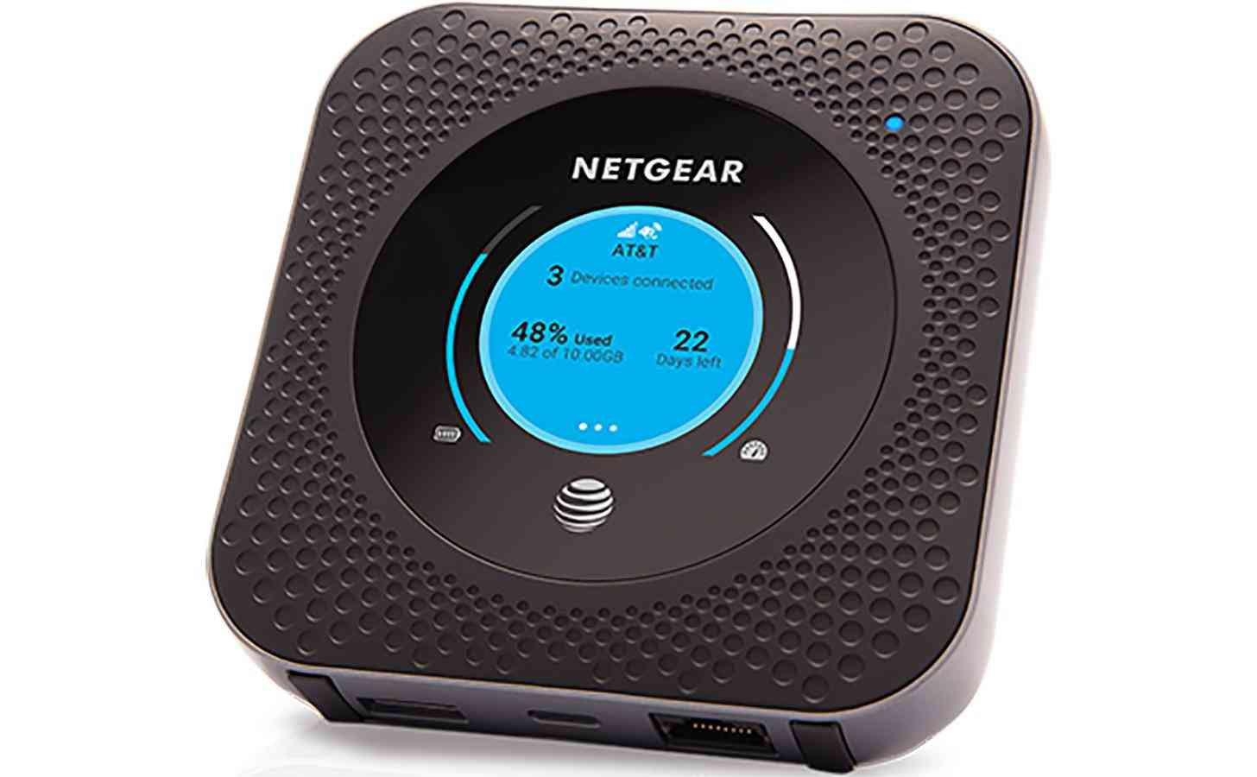
Some Early 5G Devices
Motorola moto z³ paired with 5G moto mod cover
Samsung Galaxy S10 5G
Huawei Mate X 5G Foldable
AT&T NETGEAR Nighthawk 5G Mobile Hotspot

Slide 13
(End of Chapter 2 Slides)

